Slide 1
A Short History on Linux and Friends
Myles Lynn

Slide 2
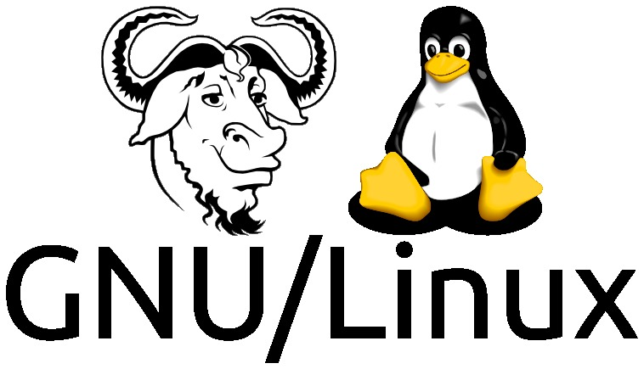
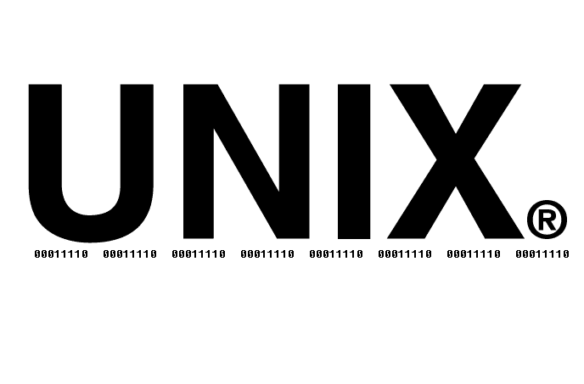
Presentation Overview
History of Unix
History of the GNU Project and the Free Software Foundation
History and Future of Linux

Slide 3
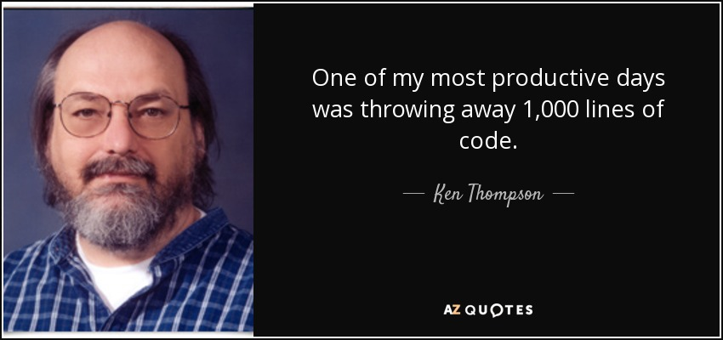
History of Unix

Slide 4
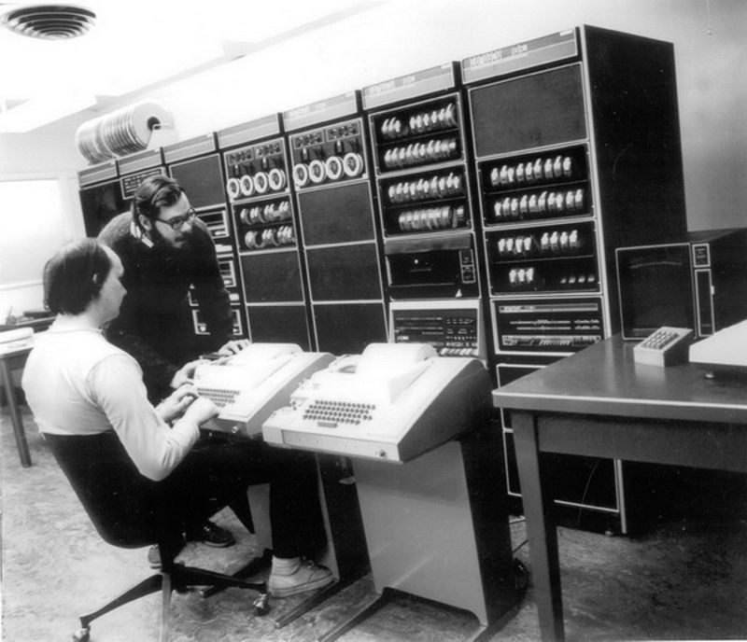
History of Unix - 1969
Ken Thompson and Dennis Ritchie computers scientists at Bell Labs write the first edition of Unix as an simpler of branch of their MULTICS system, an early time-sharing operating system.

Slide 5
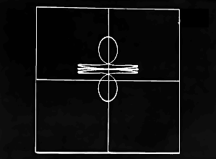
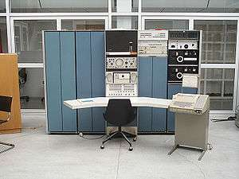
History of Unix - 1969
Ken Thompson wrote UNIX in assembly on a PDP-7 in a months time, originally as an operating system for his motion graphic game Space Travel.

Slide 6
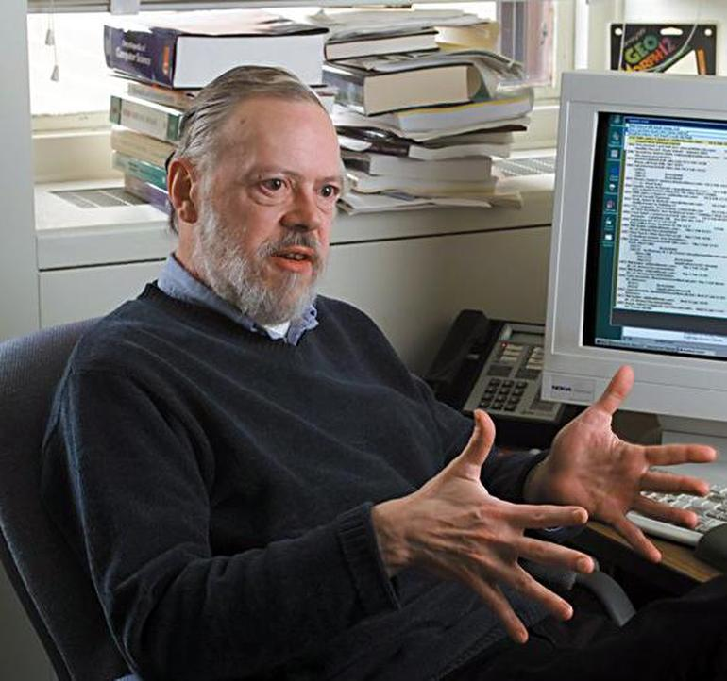
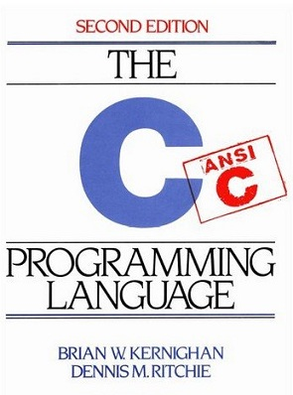
History of Unix - 1972
Dennis Ritchie, creator of the C programming language rewrites and optimizes the Unix System into C to allow portability.

Slide 7
History of Unix
Unix was formed on a “small is good” and minimalistic philosophy, alongside the idea that each program is designed to do one job well. A philosophy that would translate and carry on with Linux’s development.
Unix - Making Computers Easier to Use

Slide 8
History of Unix - 1976-77
Ken began teaching the Unix system at the University of California Berkley. Students and professors continued developing the Unix system, which eventually became BSD, Berkley Software Distributions.
This also encouraged the development of the Vi editor, C shell, virtual memory, sendmail and support for TCP/IP.
Uses of Unix at Berkeley

Slide 9
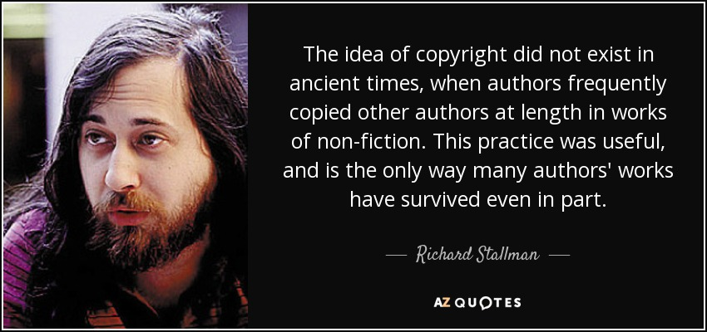
History of GNU

Slide 10
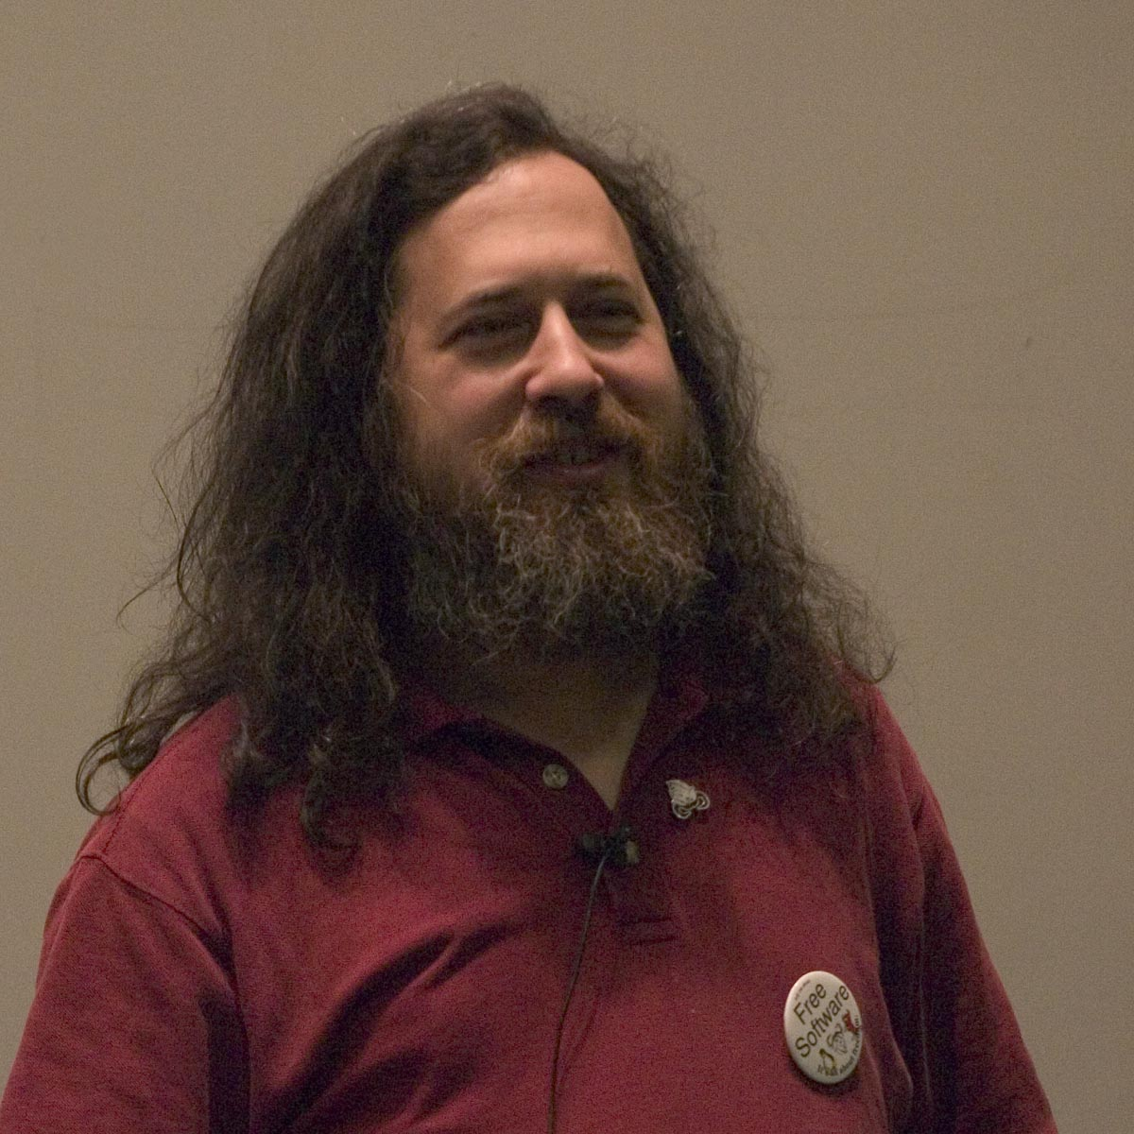

History of GNU - 1971
Richard Stallman, founder of GNU Projects, started his career at MIT and worked in a development groups that exclusively used free software.

Slide 11

History of GNU - 1980s
However, by the 1980s almost all software was proprietary. In opposition to the restrictions placed on upcoming software, Stallman believed in the principle that software should be free, as in “freedom”, and founded the Free Software Foundation and GNU Project.

Slide 12
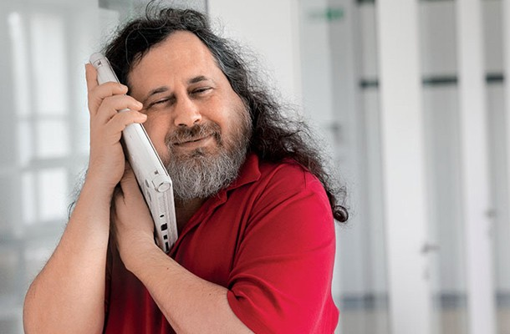
History of GNU - 1980s
So, Stallman sought after creating a full and completely free operating system that would be compatible with Unix.

Slide 13

History of GNU - 1980s
Richard Stallman alongside with a group of like minded programmers started developing a series of tools such as the well known editor Emacs, a C Compiler (GCC), libraries, and all associated generic Unix tools.

Slide 14
History of GNU - 1990s
By the 1990s, the GNU Project had either found or written all the major components except the kernel, however the Linux kernel was currently in development by Linus Torvalds, which was then put to use as the final puzzle piece to a completely free operating system.
Richard Stallman: How He Started the GNU Project

Slide 15
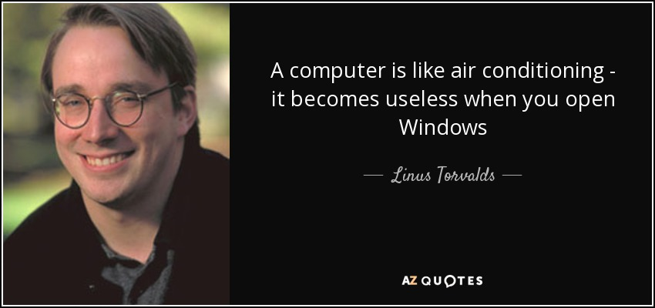
History of Linux

Slide 16
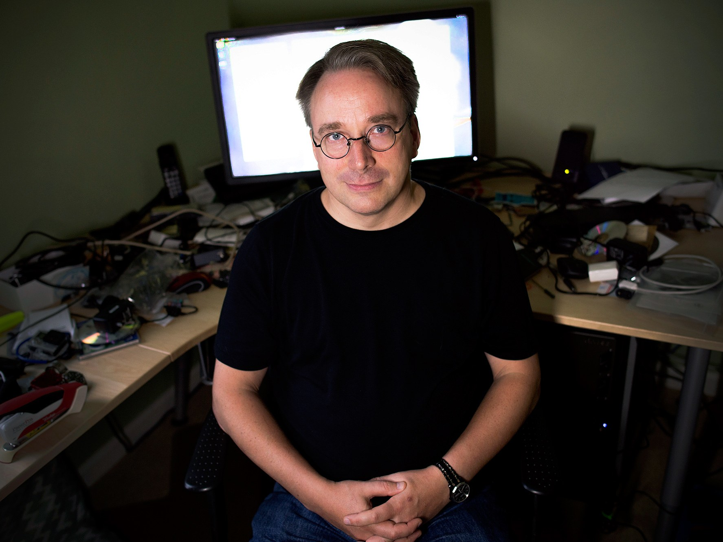

History of Linux - 1990s
Linux began as a personal hobby project by Finnish student, Linus Torvalds, with his goal to create a new free operating system kernel. A kernel being the core of an OS, with complete control over the system.

Slide 17

History of Linux - 1990s
Originally inspired by a Unix-like operating system known as Minix, Torvalds sought out the developer, Professor Andrew Tanenbaum, to upgrade the OS with new features and improvements.

Slide 18
History of Linux - 1990s
However, Tanabuam prohibited Torvalds from doing so. Torvald then took matters into his own hands to write his own free operating system kernel from scratch utilizing ideas from Minix, such as the file structure, rather than simply developing on top of Minix.
Linus Torvalds - How Linux Started

Slide 19
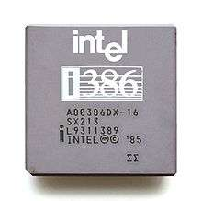
History of Linux - 1990s
So, while Torvalds was studying Computer Science at the University of Helsinki, he began the project as a class project, specifically for the hardware he was running, being a 80366 processor.
My First Line of Code: Linus Torvalds

Slide 20
History of Linux - 1990s
On October 1991, Torvalds announced online the first official version of Linux, version 0.02, being able to only mainly run Bash and GCC.
However, it continued to be improved upon, such as being capable to run large scale web hosting, networking, and production use.

Slide 21
History of Linux – Present Day
Linux is still being maintained today and will continue to be by Linus Torvalds and his team.
As of July 31st, 2015 there were over 80 million Linux users. Linux also runs on common day electronics such as televisions, thermostats, and cars. And 67% of the Internet runs on Unix or a Unix-like web server.

Slide 22
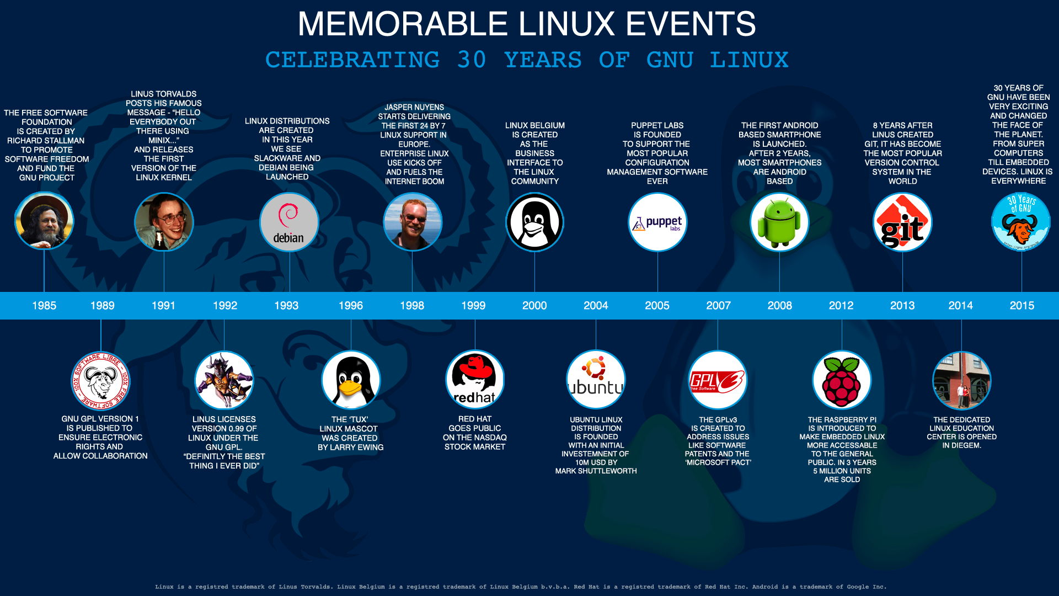

Slide 23
Sources
https://en.wikipedia.org/wiki/History_of_Linux#Events_leading_to_creation
https://www.oreilly.com/library/view/running-linux-third/156592469X/ch01s02.html
https://www.digitalocean.com/community/tutorials/brief-history-of-linux
https://www.livinginternet.com/i/iw_unix_gnulinux.htm
https://www.wired.com/2016/08/linux-took-web-now-taking-world/
http://www.aboutlinux.info/2005/11/complete-concise-history-of-gnulinux.html
https://www.gnu.org/gnu/gnu-history.en.html
http://www.unix.org/what_is_unix/history_timeline.html
http://ibgwww.colorado.edu/~lessem/psyc5112/usail/concepts/hx-of-unix/unixhx.html
https://en.wikipedia.org/wiki/History_of_Unix

